Slide 1

Computer Engineering Department
A.P. Shah Institute of Technology
G.B.Road,Kasarvadavli, Thane(W), Mumbai-400615
UNIVERSITY OF MUMBAI
Academic Year 2019-2020

Slide 2
A Project Report on
Fake News Analysis Submitted in partial fulfillment of the degree of
Bachelor of Engineering(Sem-7)
in
Computer Engineering
By
Shubham Padte(16102058)
Ashish Kothari(16102045)
Pankit Khimasiya(16102034)
Under the Guidance of
Dr. Rahul Ambekar

Slide 3
1.Project Conception and Initiation

Slide 4
1.1 Abstract
Social media for news consumption is a double-edged sword.
A large body of recent works has focused on understanding and detecting fake news stories that are disseminated on social media.
To accomplish this goal, these works explore several types of features extracted from news stories, including source and posts from social media.
Extensive spread of fake news has potential for extremely negative impacts on individuals and society.
Fake news is intentionally written to mislead readers to believe false information.
Proposed application will be implemented to verify the gentility of news.
We believe that interesting findings on usefulness and importance of features for detecting false news will prevent readers from misleading.
This project will filter news by using Natural language processing and Machine learning, by processing large dataset of news.

Slide 5
1.2 Objectives
Quick and easy to detect whether the headline is correct or fake.
To provide the user the gentility of the news.
Important aspect of this project is to correct the news and prevent the people from misleading and to prevent the chaos.
The major objective is detect fake news , which is a classic text classification problem with a straight forward proposition. It is needed to build a model that can classify “ fake” or “real” news.

Slide 6
1.3 Literature Review
Supervised Learning for Fake News Detection-This paper brieﬂy surveys on identifying and implementing main features for a variety of supervised learning classiﬁers when distinguishing fake from real stories on a large datasets.
Fake News Detection on Social Media-A Data Mining Perspective-In this paper we propose a general data mining framework including 2 phases: (I)feature extraction and (II) model construction.
Fake News Detection-This paper describes a simple fake news detection method based on one of the machine learning algorithm , naïve Bayes classifier.

Slide 7
1.4 Problem Definition
A large body of recent works has focused on understanding and detecting fake news stories that are disseminated on social media.
To accomplish this goal, these works explore several types of features extracted from news stories, including source and posts from social media.
We propose a general data mining framework for fake news detection which includes two phases: (i) feature extraction and (ii) model construction
Our proposed application will be implemented to verify the gentility of news.

Slide 8
1.5 Scope
The scope of our project Fake News Analysis is to inform the user whether the given headline or the given news is correct or fake.
The proposed system will take the input as headlines and those headlines may include journalism and scientific journal articles, satire articles, narrative fiction, opinion pieces, blogs, politically leaning news and even hate speech examples.
The received output will let user know that what kind of news may spread in the society.

Slide 9
1.6 Technology stack
The language used for this whole project will be python since it’s the most effective where data analysis is concerned
The Ide used will be jupyter notebook which is a great tool for data analysis.
The jupyter notebook is available in anaconda, also Spyder will be used for some data visualization which is also available in the same.

Slide 10
1.7 Benefits for environment & Society
Correcting the fake news is one of the most important aspects for the society.
Main goal of this project is to prevent the society for being misguided as well as spreading the rumors.
By reducing the spread of rumors there can be prevention of chaos in people.

Slide 11
2. Project Design

Slide 12
2.1 Proposed System
In this paper a model is build based on the count vectorizer or a Tf-Idf matrix i.e. word tallies relatives to how often they are used in other articles in your dataset can help
Since this problem is a kind of text classification, Implementing a Naive Bayes classifier will be best as this is standard for text-based processing.
The actual goal is in developing a model which was the text transformation(count vectorizer vs Tf-Idf vectorizer)and choosing which type of text to use(headlines vs full text).
Now next step is to extract the most optimal features for count vectorizer or Tf-Idf-vectorizer, this is done by using a n-number of the most used words, and/or phrases, lower casing or not, mainly removing stop words which are common words such as “the”, “when”, and “there” and only using those words that appear at least a given number of times in a given text dataset.

Slide 13
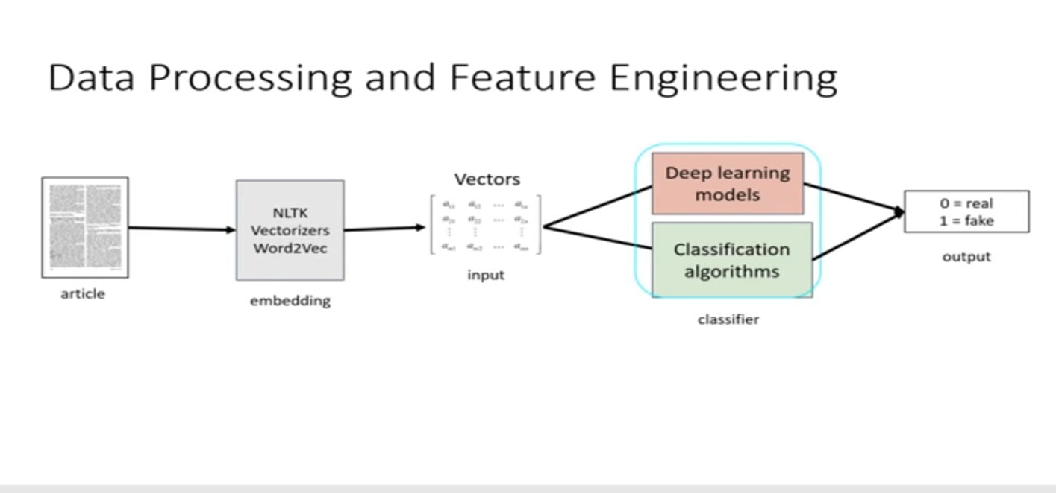
2.2 Design(Flow Of Modules)

Slide 14
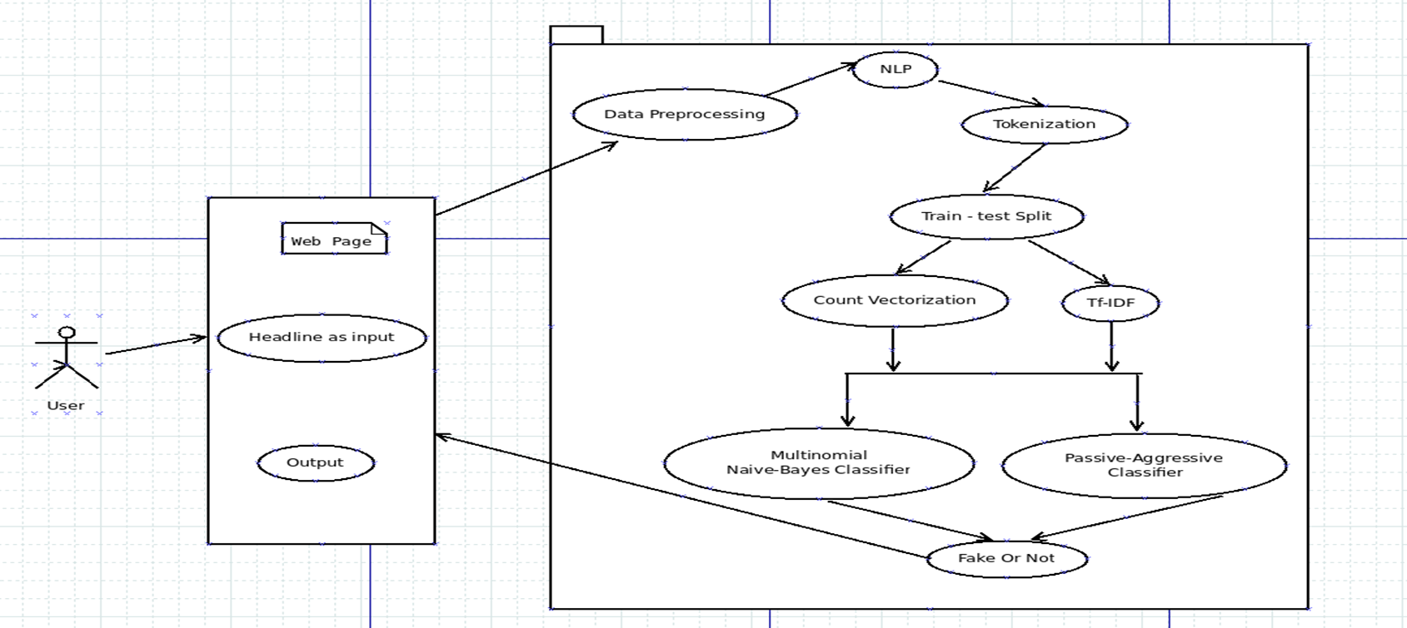
2.3 Use Case Diagram

Slide 15
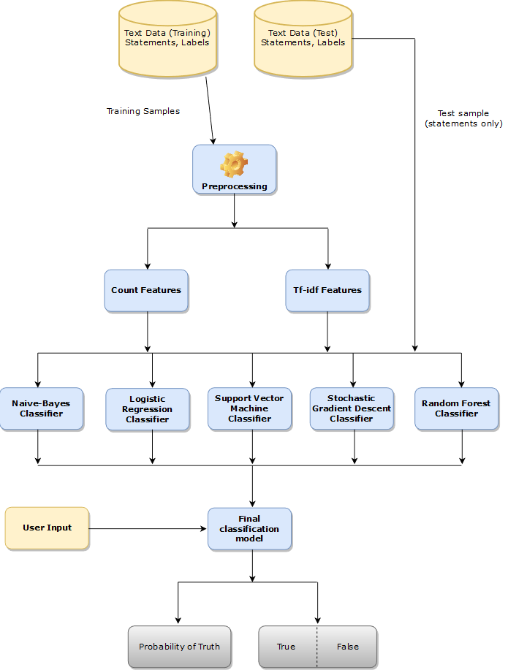
2.4 Activity diagram

Slide 16
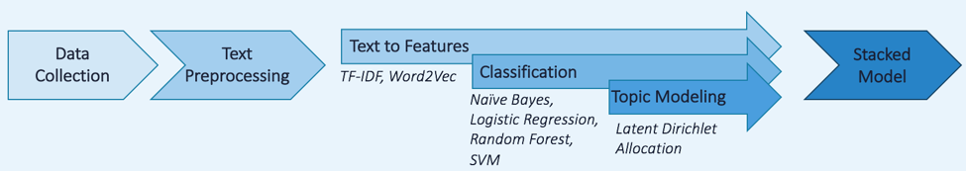
2.6 Module-1
Collect the data from dataset.
Pre-processing is done according to text.
Tokenizing is done using text to feature algorithms.

Slide 17
Module-2
Tokenized input is taken from the last input.
Different classifier methods are applied on the given output.
The classified output is given and later the model will show whether the given input is fake or real.

Slide 18
2.7 References
Julio C. S. Reis, Andre Correia, Fabricio Murai, Adriano Veloso, and Fabricio Benevenuto “Supervised Learning for Fake News Detection” IEEE research paper 2019.[1]
Kai Shu, Amy Sliva, Suhang Wang, Jiliang Tang, and Huan Liu “Fake News Detection on Social Media: A Data Mining Perspective” IEEE research paper Sep 2017.[2]
Akshay Jain, Amey Kasbe “Fake News Detection” 2018 IEEE International Students' Conference on Electrical, Electronics and Computer Sciences[3]

Slide 19
3.Planning for next semester

Slide 20
Planning
Next semester we will complete the implementation part.
Training and Testing on datasets will be done.
Application or website will be created for deployment.

Slide 21
Thank You

